Slide 1
CDC Foundation: Accessible Materials and Culturally Relevant Messages for Individuals with Disabilities
Pacific ADA Center Webinar Series
February 11, 2021
Notes:
Thank you for the opportunity to talk briefly about this important project.
This project came about when CDC heard from disability partners that the COVID-19 materials CDC was creating were not fully accessible to people with extreme low literacy skills, people who use braille, those who use American Sign Language, and others with accessibility limited by mobility issues. Partners also said that people with disabilities were not always represented in CDC’s COVID guidance and that other resources might be needed to help PWD understand how to apply the guidance. CDC staff took this idea to CDC Foundation which then funded this project.

Slide 2
Thank you to our funder!
The CDC Foundation
This project is made possible due to funding from the CDC Foundation along with technical assistance from the Centers for Disease Control and Prevention (CDC).
Notes:
CP

Slide 3
Accessibility Made Smart at CIDI
Accessibility Consulting – ICT & UX
Braille Services
Captioning and Described Audio Services
Professional E-Text Producers
Certified Assistive Technology Team
Tools for Life is Celebrating 30 Years of Service this Year!
Notes:
CP
The Center for Inclusive Design and Innovation (CIDI) is a leader in services and accessibility for people with disabilities. We serve schools, colleges, corporations, agencies, and nonprofit organizations with accessibility consulting, braille services, captioning and described audio services, accessible E-text, and a certified assistive technology team. We serve approximately 70% of the degree-granting postsecondary colleges in the U.S. with these services and our management of the Access Text Network for the Association of American Publishers. Tools for Life, Georgia’s Assistive Technology Act Program, serves all ages and all disabilities in the state. Since 2006, we have directed the National Pass It On Center, providing technical assistance for all 56 states and territories in the safe and effective reutilization of AT for those who are uninsured or underinsured.

Slide 4
Today’s Session
Georgia Tech’s CIDI team, through funding provided by the CDC Foundation and with technical assistance from CDC, is adapting CDC’s COVID-19 guidance into accessible formats for people with disabilities.
Presenters will share information about this project including statistics on individuals living with disabilities during the COVID-19 pandemic, history of the project, and real-time resources for you as we collectively work to distribute this vital health information to those who need it most.
Notes:
LIZ CP

Slide 5
Learning Objectives
Upon completion of this webinar, participants will be able to:
Identify
List
Name
Name the accessible resources that are available through the COVID-19 Accessible Materials for People Disabilities Project.
Identify 2 ways that people with disabilities have been disproportionately affected by the COVID-19 pandemic.
List 3 targeted disability specific audiences that will be receiving the accessible materials.
Notes:
LIZ SAM

Slide 6
ABOUT THIS PROJECT: Accessible Materials for People with Disabilities
Background and purpose
What are we providing?
Who needs these resources?
How will we reach our target audiences?
How can you can help us?
Q&A
Notes:
CP LIZ SAM
We noted the feedback that triggered this partnership with the CDC Foundation. Our mission is to assist in improving the accessibility of existing materials.

Slide 7
What are we providing?
A technique for developing ASL video scripts that use “native ASL” for more effective communication with Deaf users
Easy access to braille, embossed or digital for refreshable braille displays
Text simplified below Plain Language guidelines
Web accessibility and best practices beyond Section 508 compliance
Education and training resources to support the dissemination of the improved products and to share the processes for future uses
Notes:
CP LIZ SAM
Not all materials that are compliant with Section 508 are accessible to all. Sometimes that requires additional steps. With a partner, we are engaging in the important development of text simplification to reach individuals with extremely low literacy levels.

Slide 8
Who needs these resources?
Our specific target audiences are:
Deaf or hard of hearing users of ASL
Blind or low vision individuals who use braille
Individuals with extremely limited literacy skills
Individuals with mobility issues that limit access to information
Families, caregivers and various healthcare providers who may benefit from the enhanced modes of messaging
Some individuals who may have combinations of these disabilities and some of the message formats may be used by multiple audiences
Notes:
LIZ SAM

Slide 9
Project Background
COVID-19 has disproportionately affected many groups, including the 61 million people in the United States living with a disability.
While the COVID-19 guidance on CDC’s website is accessible for some people with disabilities as required by Section 508 of the Rehabilitation Act (e.g., those using assistive technology devices, closed captions on videos, etc.), content is needed in alternate formats such as simplified text, braille, and American Sign Language (ASL) videos.
It is important that COVID-19 guidelines are not only accessible to people with disabilities but also consider cultural challenges that people with disabilities face while trying to follow them.
Notes:
CP

Slide 10
Go Beyond Accessibility Guidelines
All individuals, with or without disabilities, have their own preferred learning modes. The offering of products in a variety of formats provides greater access for everyone.
Going beyond accessibility considerations to address those preferences will introduce some products with wide-ranging benefits.
For example, those may include videos with practical information on cleaning surfaces, computers, and mobile devices to avoid disease transmission, how to sanitize durable medical equipment, or how to use touchless strategies for grocery shopping.
Notes:
CP

Slide 11
Needs Assessment and Message Testing
CIDI conducted a needs assessment with individuals with disabilities, as well as organizations that serve disability audiences, to inform this project.
Adapted materials have been message tested with target audiences to ensure accurate translation and cultural relevancy to people with disabilities.
Notes:
CP

Slide 12
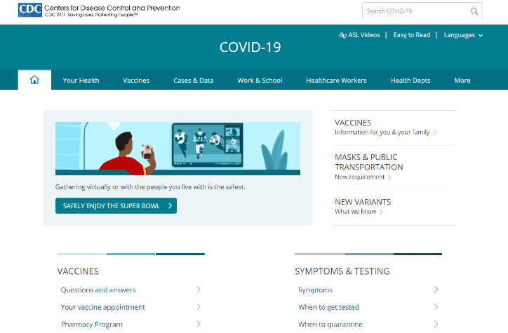
COVID-19 Accessible Resources
Easy to Read materials created through this project are available on the CDC website. ASL videos created through this project will soon be posted to CDC’s ASL YouTube Channel
www.cdc.gov/coronavirus
Notes:
SAM

Slide 13
Improving ASL Videos
ASL is a primary language, not a translation of English, for deaf individuals who use it.
Videos need to be in native ASL. We are working with CDC on a modified process to develop video scripts in native ASL.
ASL users also need:
Easily identifiable videos
Messaging about CDC guidance through channels they use frequently
Notes:
CP
The videos should be in native sign language more understandable to the deaf population . They should not be word-for-word transcriptions of English text.

Slide 14
Making Braille Easily Available
Digital, braille-ready files
Documents remediated for accessibility
Available for download to refreshable braille displays
Embossed Braille
Available through partners
Available by individual request through the CIDI microsite
Notes:
CIDI’s braille department is a member of the Braille Association of North America and includes Library of Congress certified transcribers. The department will support the production of CDC guidance in embossed braille for the minority of blind individuals who use it, and will use the websites and partnerships to make digital files easily available to braille users who have refreshable displays.

Slide 15
Simplified Text
Simplified text is needed for those with limited literacy skills from a variety of causes.
This requires simplification much lower than the Plain Language guidelines – content at or below 3rd grade level. We are “simplifying” CDC guidance to this level.
The process and tool, developed by partners at the University of North Carolina – Chapel Hill, Center for Literacy and Disability Studies, School of Medicine, is ground-breaking research and an application of research-based findings.
Notes:
CP

Slide 16
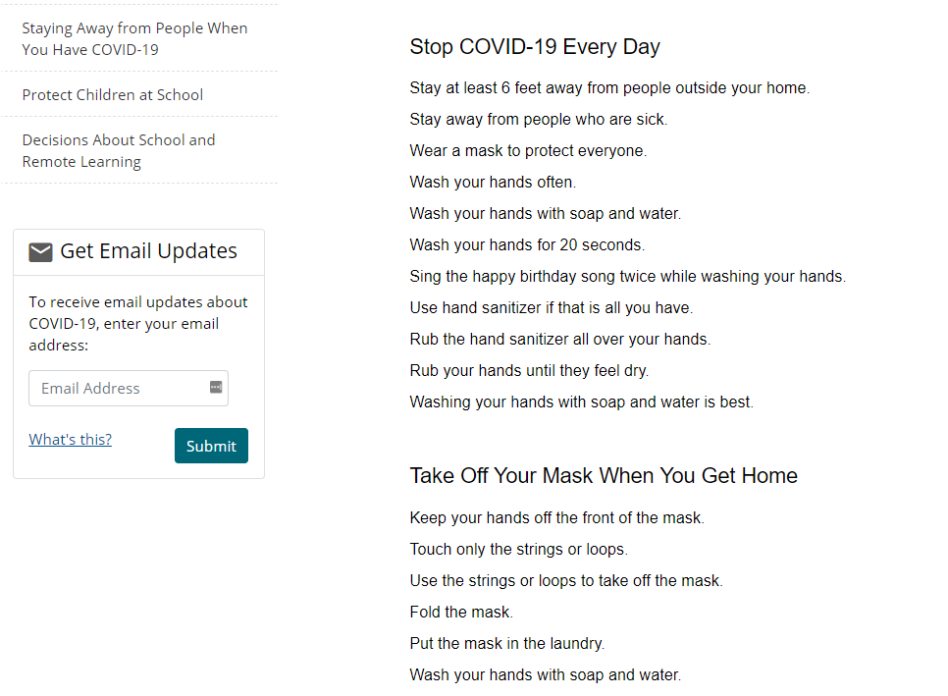
Easy to Read
Notes:
SAM

Slide 17
Consulting Services: 508 / Best Practices
Accessibility sometimes requires best practices that go beyond Section 508 compliance.
Webpage accessibility
PDF Remediation
Notes:
CP

Slide 18
Reaching Our Target Audiences
The Dissemination Plan is a tiered approach to partner with organizations serving target audiences, capitalizing on existing channels to reach those who need accessible resources.
Our partners at American Association on Health and Disability (AAHD) have been instrumental in outreach and dissemination.
Notes:
LIZ

Slide 19
Dissemination of Content and Messages
Identification of potential dissemination partners was undertaken with CDC Foundation and partners.
A webinar was hosted on November 11 for interested parties to explain details of the partnership.
Messages made available for outreach and social media use templates for Twitter, Facebook, Instagram, and email outreach, etc.
Notes:
LIZ

Slide 20
Webinars and Trainings
Additional webinars have been hosted and archives can be accessed on the Georgia Tech microsite. www.cidi.gatech.edu/covid/training
Webinar topics covered:
Apps for Promoting Independence and Safety (Nov. 12, 2020)
Sanitization of Personal Durable Medical Equipment (Nov. 18, 2020)
A Closer Look: Face Masks and People with Disabilities (Dec. 9, 2020)
A Closer Look: Mental Health and Resilience within the Disability Community during COVID-19 (Dec. 16, 2020)
Making Social Media Accessible for People with Disabilities (Jan. 20, 2021)
A Closer Look: Guidance for Busines and Employees Considering the Needs of People with Disability during COVID-19 (Feb. 10, 2021)
Notes:
LIZ

Slide 21
Microsite
The microsite at Georgia Tech/CIDI will:
Link to CDC guidance, videos, etc.
Host some accessible materials.
Host education, training and supplementary resources.
www.cidi.gatech.edu/covid
Notes:
SAM

Slide 22
Outreach
Please reach out to learn more about how you can help distribute this vital health information to those that need it most.
training@gatfl.gatech.edu
Notes:
LIZ

Slide 23
Questions and Answers

Slide 24
We appreciate your time!

